Slide 1
CS 4641 Project: Small Data Big Dreams
By: Gabe, Hannah, Hyuk, Lucy, Rohan

Slide 2
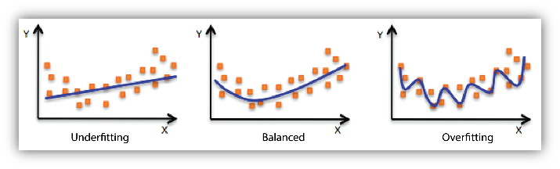
The Importance of Data Augmentation, Synthetic Data, and Transfer Learning
Mitigate overfitting with data augmentation
Increase dataset size with synthetic data
Improve model generalizability through transfer learning
Essential tools when working with small datasets

Slide 3
Problem Statement
Data augmentation today is still limited by the effectiveness of current approaches.
This project experiments with different data augmentation and transfer learning techniques on image classification and tabular regression problems to shed light on current progress.
Notes:
Finding an effective data augmentation approach can be challenging.
Shed light on some of the challenges and progress in the field

Slide 4
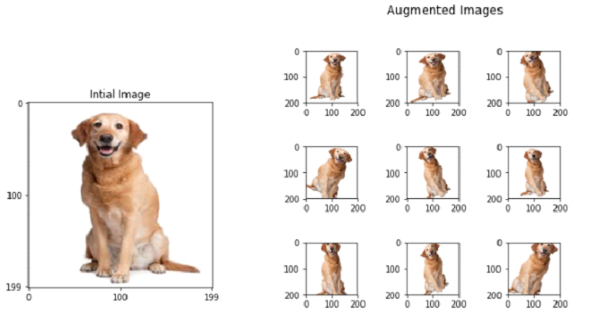
Methods
Data augmentation:
Random croppings, rotations, adding Gaussian noise…
Synthetic data using generative models:
GAN: train on existing dataset
Diffusion model: textual inversion
Transfer Learning:
Fine tune large classification model

Slide 5
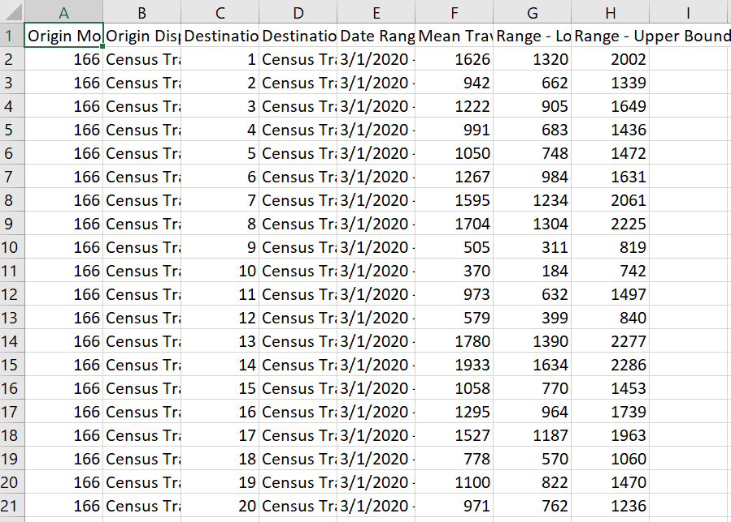
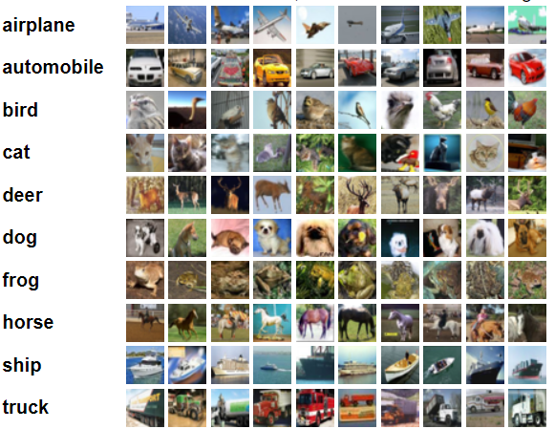
Datasets
Tabular Regression: Uber Movement Times
https://movement.uber.com/cities?lang=en-US
Image Classification: CIFAR-10
https://www.cs.toronto.edu/~kriz/cifar.html

Slide 6
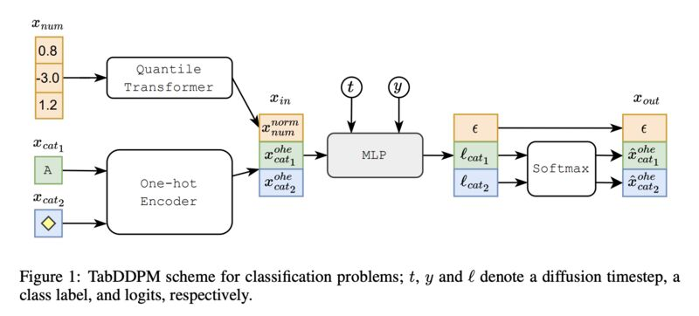
Novel Small Data Method #1 (Tabular Regression) - TabDDPM
TabDDPM is a multinomial diffusion model that can be universally applied to any tabular dataset
Excels in handling mixed data (numerical and categorical features), generating higher F1 scores across a variety of datasets when compared to GAN and VAE models
Suitable for privacy-oriented setups, generating high-quality synthetic data that maintains privacy by not revealing the original data points from the real dataset.
https://arxiv.org/abs/2209.15421
https://github.com/yandex-research/tab-ddpm

Slide 7
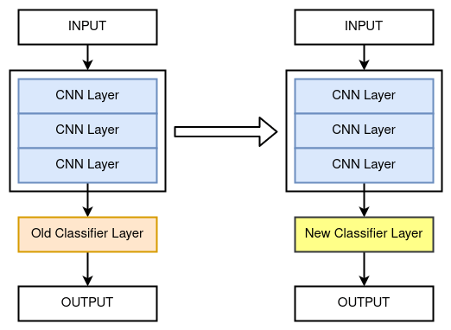
Novel Small Data Method #2 (Image Classification) - BiT
“Pre-training and fine-tuning" transfer learning approach, where the pre-trained model is fine-tuned on the downstream task.
Similar to traditional transfer learning, but BiT fine-tunes the entire model rather than just the last few layers.
Demonstrates superior performance on smaller datasets (CIFAR-10 and CIFAR-100) compared to ImageNet-based transfer learning.
Adopts a modified ResNet architecture with increased width and depth, contributing to enhanced performance
https://arxiv.org/abs/1912.11370
https://github.com/google-research/big_transfer
Notes:
BiT = Big Transfer

Slide 8

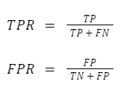
Potential Results/Discussion
Classification:
Fowlkes-Mallows (FM) Measure:
Area Under Curve Receiver Operating Characteristic (AUC - ROC):

Slide 9


Potential Results/Discussion
Tabular:
Root Mean Square Error (RMSE):
Mean Absolute Error (MAE):

Slide 10
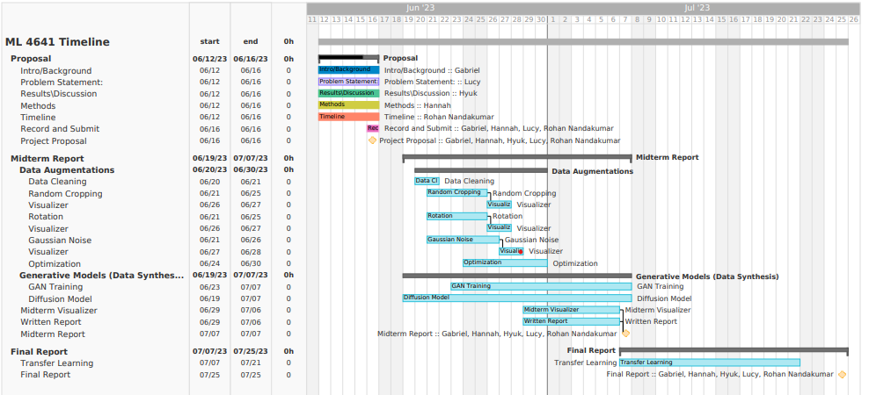
Timeline

